Slide 1
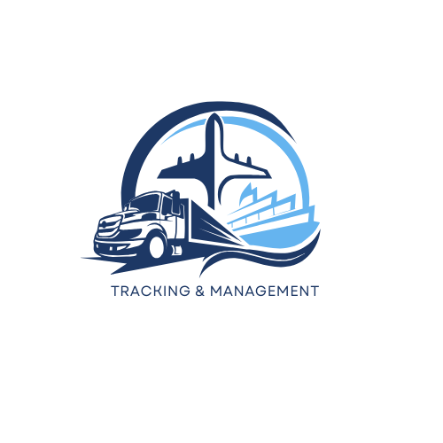








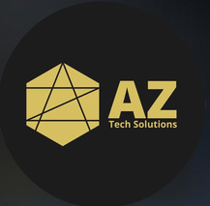
DEBUGGERS
OSAMA HEGAZY
BELAL ELKHATEEB
MOHAMED ELKHATEEB
MARIAM BAKER
MAI AHMED

Slide 2

TRACKING MANAGEMENT SYSTEM

Slide 3

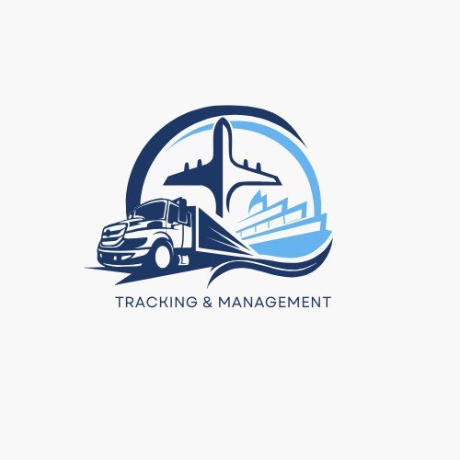
INTRODUCTION
To provide comprehensive tracking and management solutions for vehicles and assets

Slide 4
1
UNSAFE DRIVING BEHAVIOR
2
LACK OF REAL-TIME VEHICLE INSIGHTS
3
MISSED MAINTENANCE SCHEDULES
PROBLEM STATEMENT
4
INEFFICIENT FLEET MANAGEMENT
5
INABILITY TO TRACK HISTORICAL DATA

Slide 5
1
MONITOR PATTERNS, GENERATE REPORTS AND INCENTIVIZE SAFE DRIVING
2
LIVE GPS TRACKING AND IOT-ENABLED DASHBOARDS
SOLUTIONS
3
CENTRALIZED TRACKING, AI-BASED ROUTE OPTIMIZATION
Store and analyze usage, tracking, and maintenance records
4
5
STORE AND ANALYZE USAGE, TRACKING, AND MAINTENANCE RECORDS

Slide 6
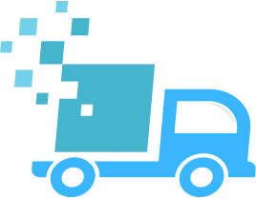



LOGISTICS AND TRANSPORTATION COMPANIES
Public Transport Providers
AUDIENCE
Emergency Services
Food and Beverage Distribution

Slide 7
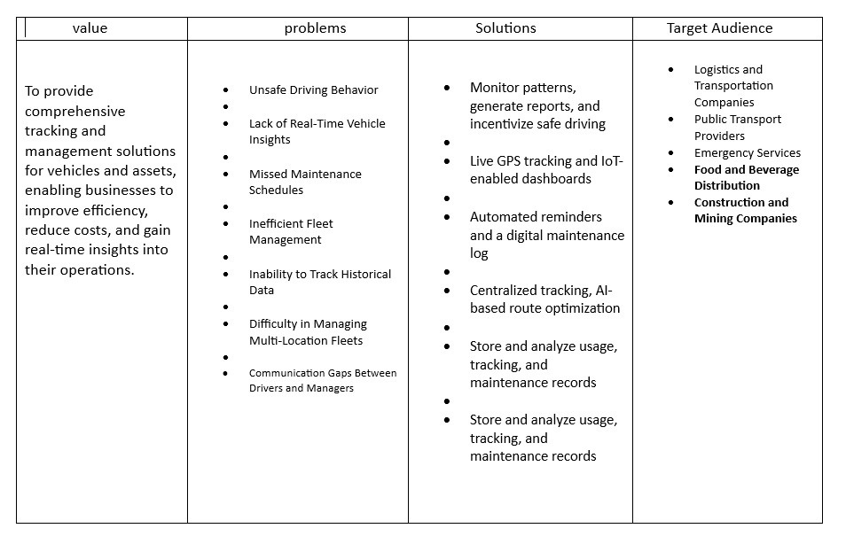

Slide 8




Futuer Plan
1
2
3
4
5
AI-Powered Predictive Analytics:
Driver Scoring and Coaching
Synchronize with city traffic infrastructure for optimal routing
Integrating dashcam and Video Telematics
AR-Based Maintenance Assistance

Slide 9
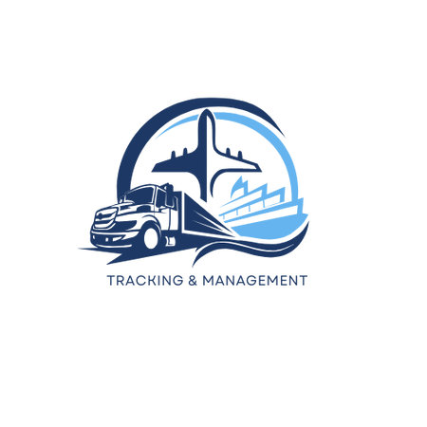
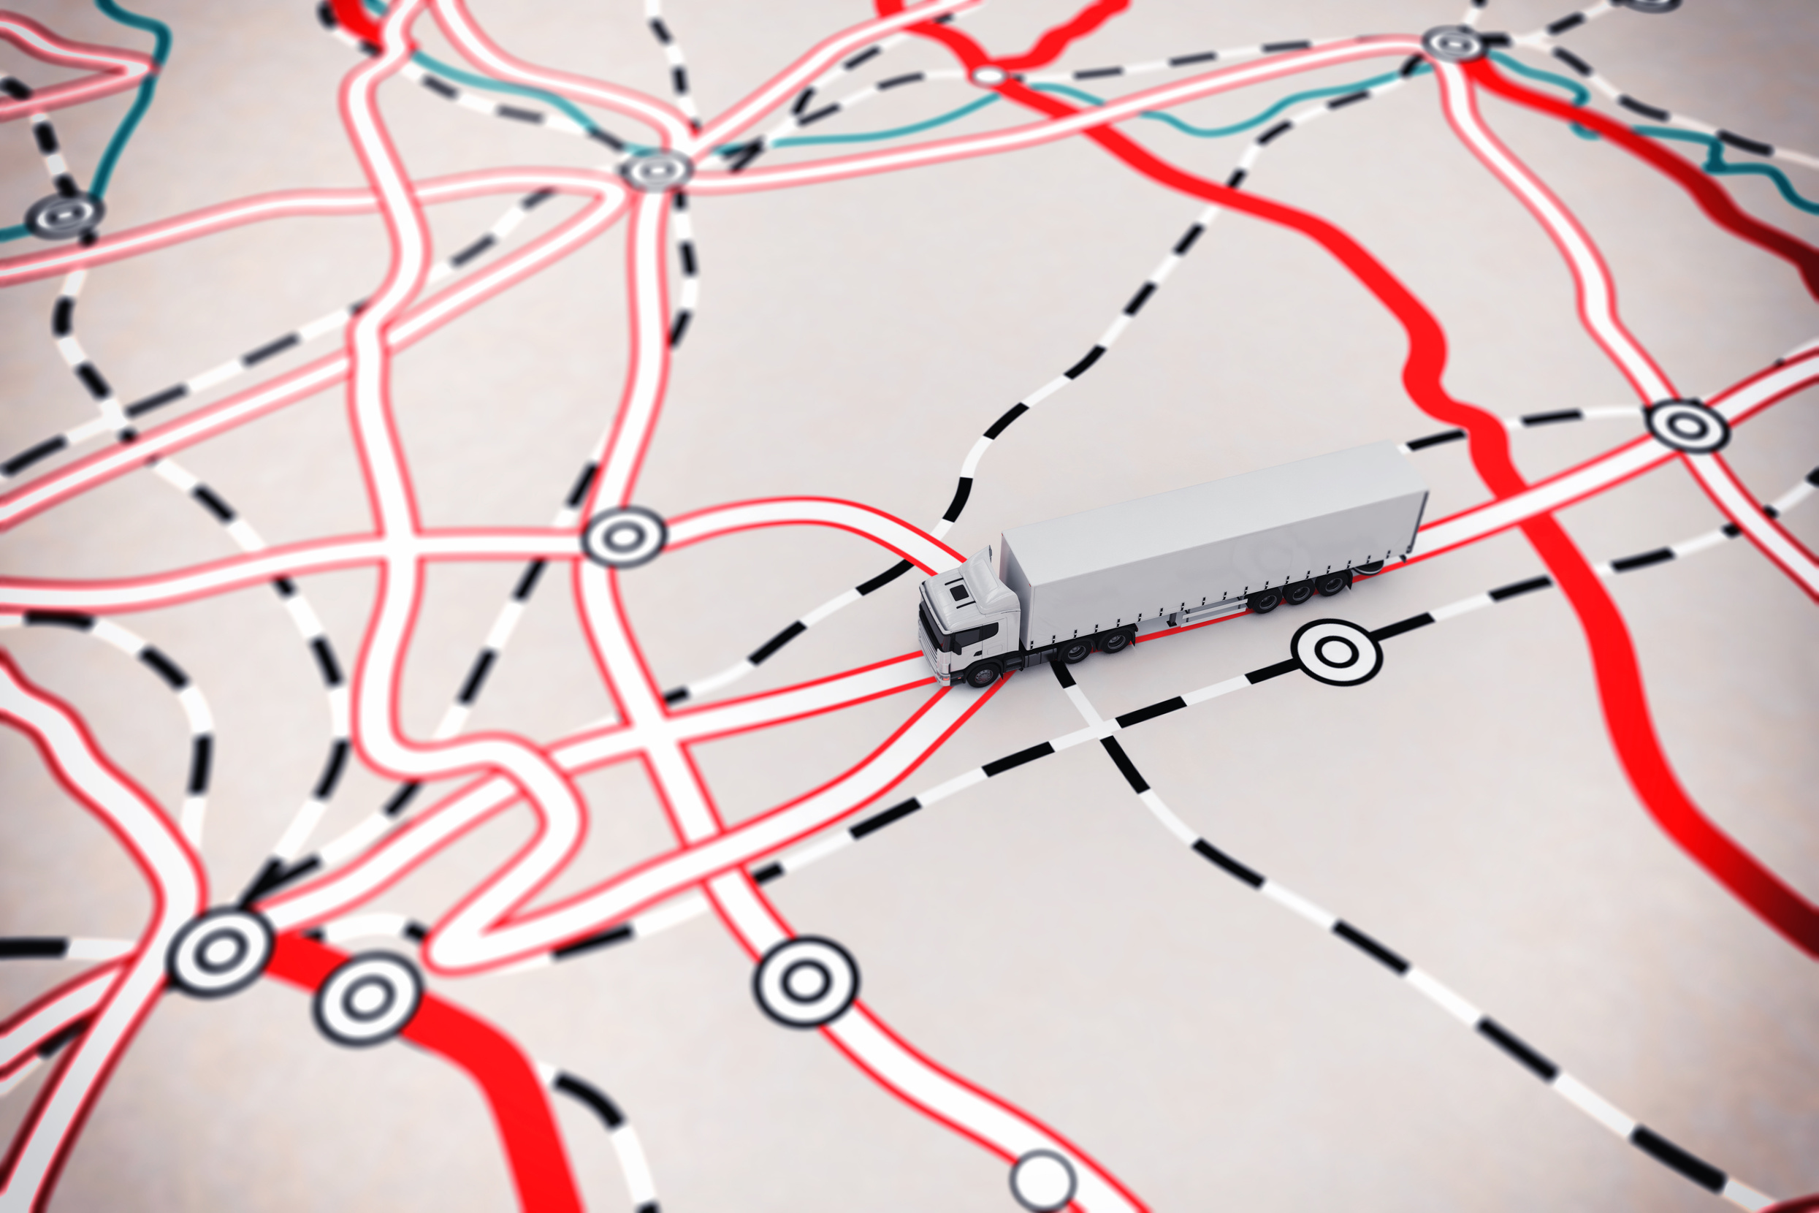
THANK YOU
DEBUGGER

